Slide 1
Team #2
Students:
Anni Kang, Yongha Jang, Melody Feng, Carlos Salazar, Jane Yun
Executive Coach:
Deepa Pai, Managing Director, Technology - Accenture
Phase 1 - HIQ
“How can the implementation of a targeted educational platform, emphasizing certification and licensing, revolutionize the attraction and retention of young talent in the manufacturing industry, thereby bridging the skills gap and fostering industry growth in line with future labor market demands?”
Phase 2 - Data
EDA - correlation between wage and certification
Clean null values
Random Forest Regression
Certificates → higher wages → more applicants → booming industry
Phase 3 - Solution
Website to submit resume that suggests in-demand manufacturing skills and provides online links/pipelines to local skill-building resources to eventually Serve as a central hub for essential manufacturing skills
Notes:
Add your name here please :)

Slide 2

Team #2

Slide 3
Team #2
2024 Super Analytics Challenge Team 2
Yongha Jang
Master of Business Administration and Management Information Systems @ University of Pittsburgh
Melody Feng
Master of Marketing Science and Business Analytics @ University of Pittsburgh
Carlos Salazar
Master in Analytics and Information @ Duquensne University
Anni Kang
Master of Business Intelligence & Data Analytics @ Carnegie Mellon University
Jane Yun
Master of Business Analytics @ Pennsylvania State University
Deepa Pai
Managing Director, Technology - Accenture

Slide 4
Agenda
2024 Super Analytics Challenge Team 2
1
HIQ Overview
2
Solution Overview
3
Solution Breakdown

Slide 5
HIQ Overview
2024 Super Analytics Challenge Team 2
Phase 1 & Phase 2

Slide 6
Connection from HIQ to Solution
2024 Super Analytics Challenge Team 2
HIQ
How can implementation of a targeted educational platform, emphasizing certification and licensing and harnessing the power of analytics, revolutionize the attraction and retention of young talent in the manufacturing industry, thereby bridging the skills gap and fostering industry growth in line with future labor market demands?
1
Phase 1: Innovating Workforce Development in Advanced Manufacturing Phase 2: Enhance Workforce Appeal via Certification & Skill Development
2

Slide 7
Solution Overview
2024 Super Analytics Challenge Team 2
Phase 3

Slide 8
Phase 3: Solution & Future Directions
2024 Super Analytics Challenge Team 2
Why is this solution and model important?
Urgent issue of skilled worker shortages
Align workforce skills
Enhance employability and economic competitiveness
Data availability for analysis
Our Solution: Bridging Skills Gaps and Enhancing Employability
Free online platform to identify skill gaps and offer targeted training
Supports job seekers and employers
Looking Ahead: Scalability and Impact
Three-stage strategy, scalable to other demographics and locations
Eventual Costs: $100K-$300K; requires collaboration for impact
Promise GDP growth by boosting human capital & workforce adaptability
Notes:
Why is this solution and model important?
By tackling the urgent issue of skilled worker shortages in the advanced manufacturing sector by offering personalized, data-driven training and certification pathways.
This pathway is designed to rapidly align workforce skills with the evolving technological demands, enhancing employability and economic competitiveness
Who benefits from it?
Young job seekers benefit by gaining accessible pathways to higher wages and better job prospects, while manufacturers receive a more skilled and adaptable workforce, crucial for innovation and growth. The wider community benefits from economic stability and growth, making this solution a cornerstone for sustainable development in the advanced manufacturing ecosystem.
Our Solution: Bridging Skills Gaps and Enhancing Employability
Launched a free online platform designed to identify skill gaps in young workers and provide targeted training for the advanced manufacturing sector in Pennsylvania.
The platform supports job seekers and employers by aligning training initiatives with the industry's evolving needs, effectively addressing staffing shortages and the rapid pace of skill changes.
Looking Ahead: Scalability and Impact
Outlined a three-stage deployment strategy focusing on young workers, with the potential to expand to other demographics and geographic locations.
Anticipated initial costs ranging from $100K to $300K, emphasizing the need for collaborative efforts among government, schools, and businesses for sustainable impact.
Highlighted the potential for substantial GDP growth through investment in human capital, underlining the platform's role in fostering a skilled and adaptable workforce.

Slide 9
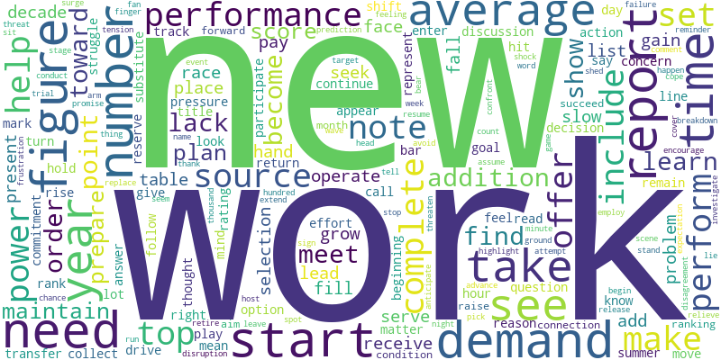
Labor market has changed…
“50% of all employees will need reskilling by 2025.”
World Economic Forum's Future of Jobs Report

Slide 10
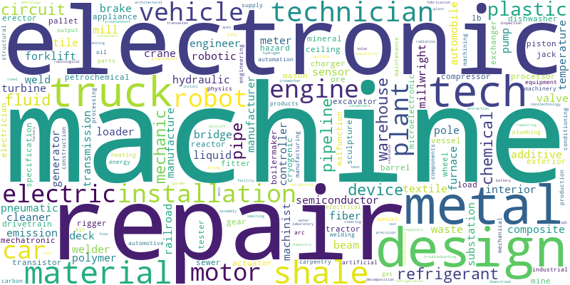
Workers must be lifelong learners
To design more effective solutions we need to compare what skill sets workers have vs. what skills companies demand
Skills Inventory

Slide 11
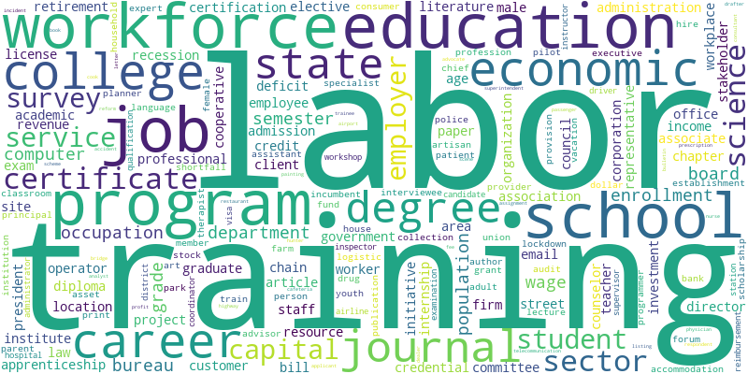
Education & training must be updated regularly
Through this approach, we'll supply the skilled workforce pipeline essential for PA's advanced manufacturing industry

Slide 12
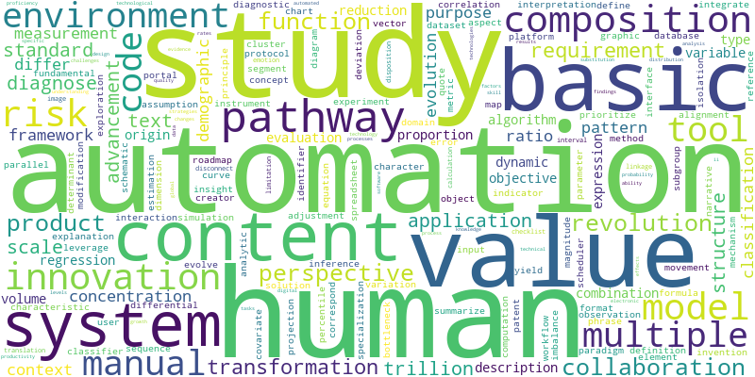
Mind the human aspects of automation
“New technologies can create new tasks to balance out those that get automated.”
Acemoglu & Restrepo
MIT
Reinstatement Effect

Slide 13
Our mission
"We aim to harness the power of analytics, to offer information and support to all stakeholders involved in maintaining a vibrant and healthy advanced manufacturing labor market."

Slide 14
Solution Breakdown
2024 Super Analytics Challenge Team 2
Phase 3

Slide 15
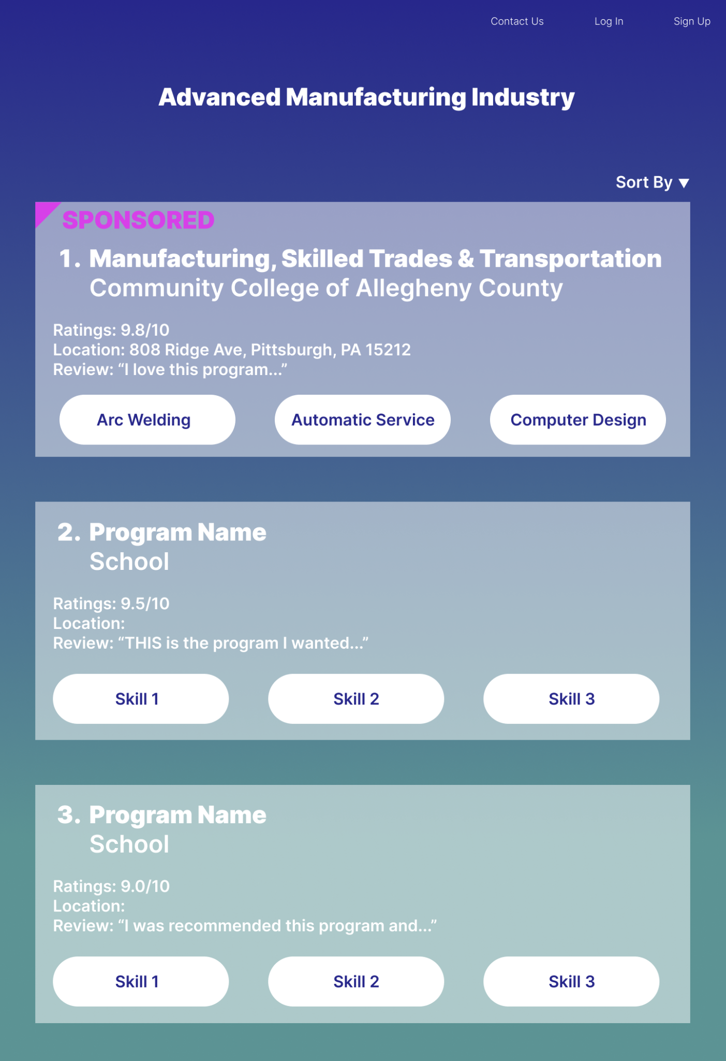
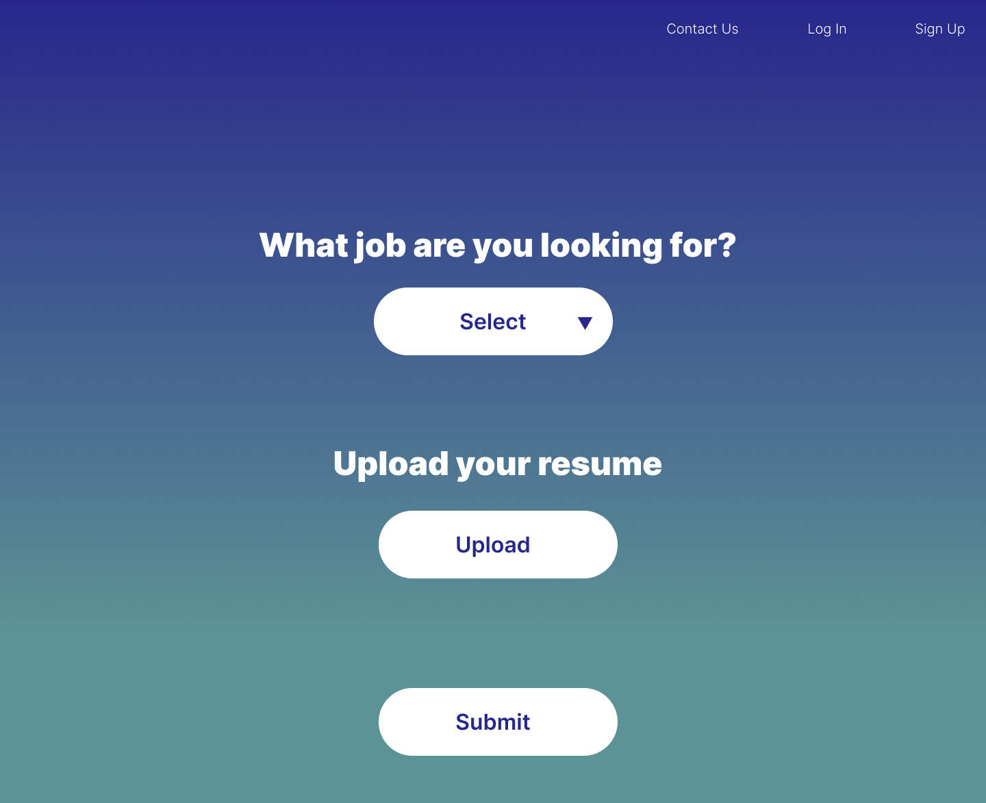
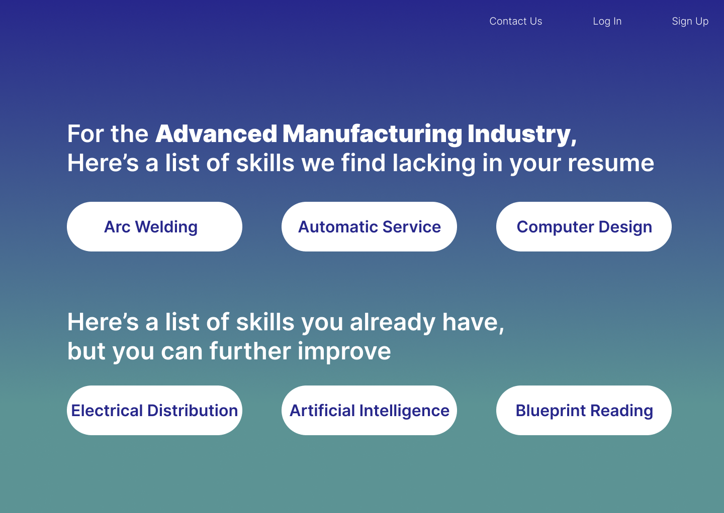
Web Page Mockups
2024 Super Analytics Challenge Team 2
Notes:
How will you market your website? Include that marketing narrative to the solution
Personalized services — Marketing to the student population
Participation in School Recruitment Sites — Promoting applications
Collaboration with school career development centers — Extensive use of the platform in the student job search process
Recording of tutorials and on-site instructions — Let users understand how to use the platform more clearly, expand their network & promote the product by instructing students to use the application on site

Slide 16
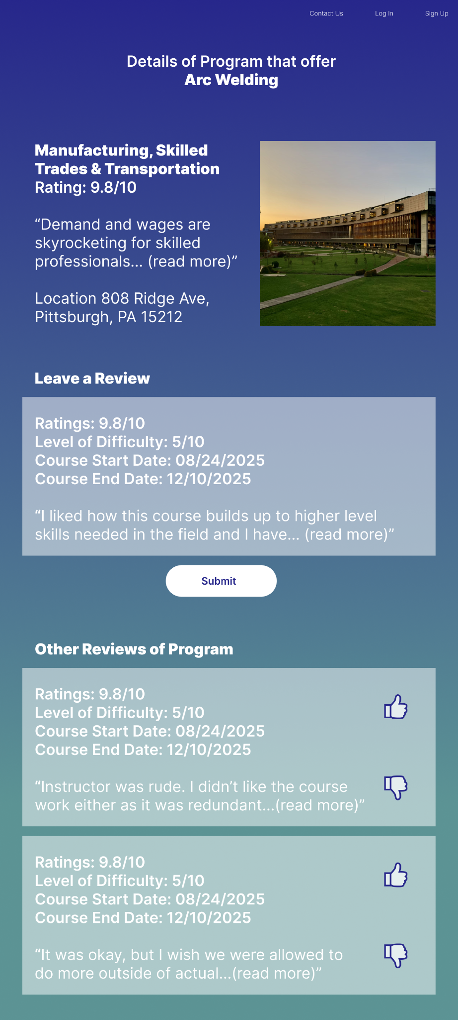
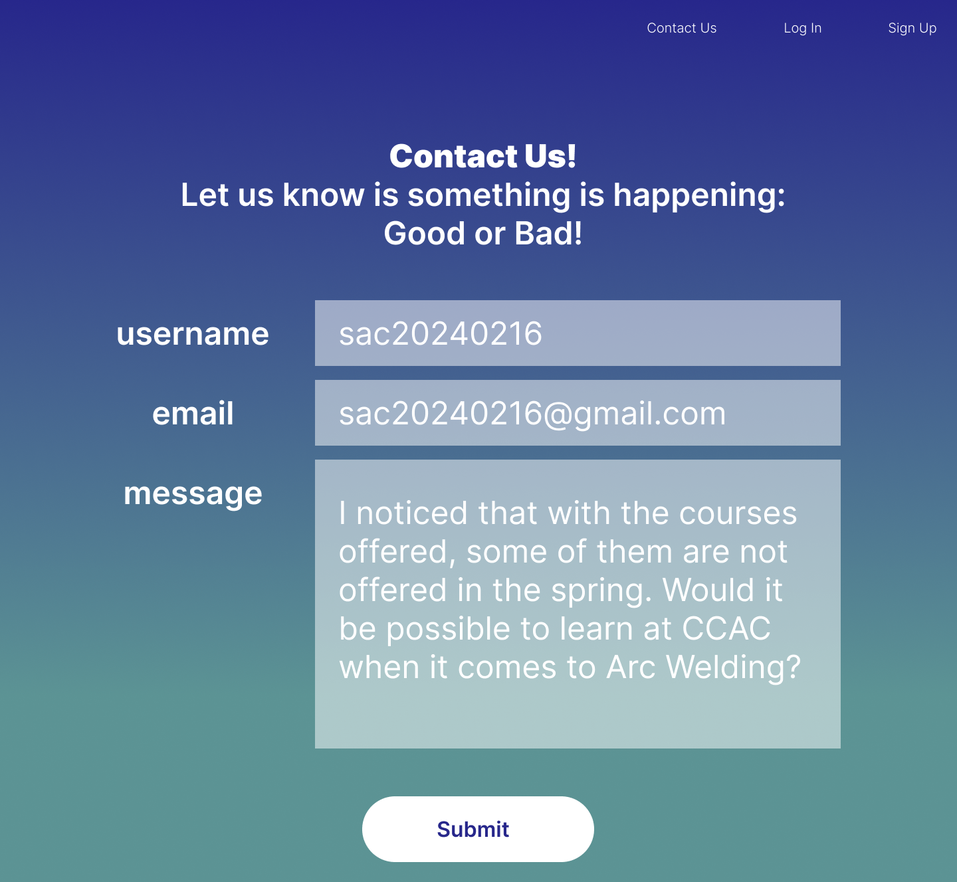
360 Feedback Loop
2024 Super Analytics Challenge Team 2
Notes:
DONT USE THE WORD IMPORTANT (> ALL OF THE SOLUTION IS IMPORTANT NOT ONLY THIS PART) How do we validate that the student has taken this course? >>Transcript? Cross-validation with school >> What incentives we give to the user/student? (show job openings as incentive after upload???)

Slide 17
Cost Effectiveness & Sustainability
2024 Super Analytics Challenge Team 2
Initial launch cost $ 128,000 — $ 153,000
Software engineers $103,000
Domain (75 pages) $ 10,000 — $ 35,000
Annual maintenance up to $15,000
Annual Cloud storage $ 120
Sustainability is high
Constant evolution based on data
Expansion of data
Source: USANEWS, Indeed Software Engineer PA Cost, Forbes How much does it cost for a website 2024 guide

Slide 18
Marketing Actions
1
Initial Stage
Web scraped data
2
Advertising Stage
info session & social media to attract users
Promoted content to attract sponsorship
3
Long-term goal
Partnership for internal data
Premium users for more insights
Notes:
Stage 1:没钱的时候，找data, 找公司的赞助
Stage 2: 获得资金支持后扩大用户数量，推广产品
Stage 3: 有了一定发展之后：壮大....

Slide 19
Next Steps (one year plan)
Moving forward
Continue to contact community colleges & companies for data & funding
Continue website maintenance & data updates
Implement premium membership for website
Marketing to students
Participating in School Recruitment Sites to promote applications
Collaborating with school career development centers
Onsite networking & coaching to expand network & promote the product
Construct social media pages to promote to target demographic

Slide 20
Next Steps (cont.)
Partnership with different organizations
Talent Recruitment with PA government, NPOs
Obtain funding and data support
Ongoing protection of user's data privacy
360 feedback loops
Plugins/Chrome extension to protect & track user data privacy

Slide 21
Citations
2024 Super Analytics Challenge Team 2
USANEWS
Indeed Software Engineer PA Cost
Forbes How much does it cost for a website 2024 guide

Slide 22
QnA
2024 Super Analytics Challenge Team 2
Team 2

